Slide 1
Demographic Information of Factor Indicators

Slide 2
We collected the 19 factor indicators described in Section 4.4, and the boxplot of these indicators is shown in Figure 1. Considering that the maximum values of part of the indicators are too large, we list statistics for these indicators in Table 1.

Slide 3
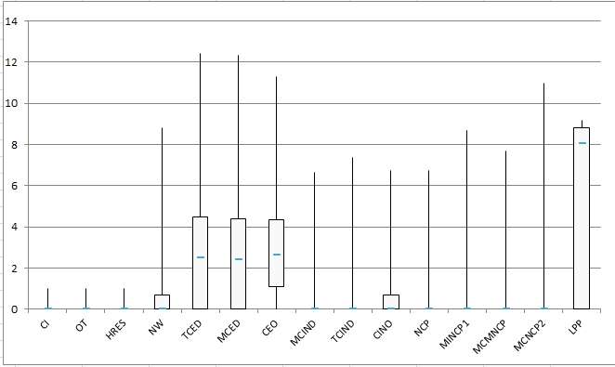
Figure 1

Slide 4
Table 1
 | NCM | NED | NI | MCNCP
Min | 0 | 0 | 0 | 0
Quartile | 0 | 0 | 0 | 0
Median | 1 | 1 | 0 | 0
Third quartile | 1 | 1 | 0 | 0
Max | 404 | 403 | 950 | 794

